Slide 1
Reproducible Research in R
An Introductory Workshop on Reproducible and Collaborative Coding

Slide 2


Instructors
Dr. Marissa Dyck (she/her) – marissadyck17@gmail.com
Postdoctoral Research Fellow
University of Victoria
Victoria, BC, Canada
Dr. Erika Barthelmess (she/her) – barthelmess@stlawu.edu
Professor of Biology
St. Lawrence University
Canton, NY, USA

Slide 3
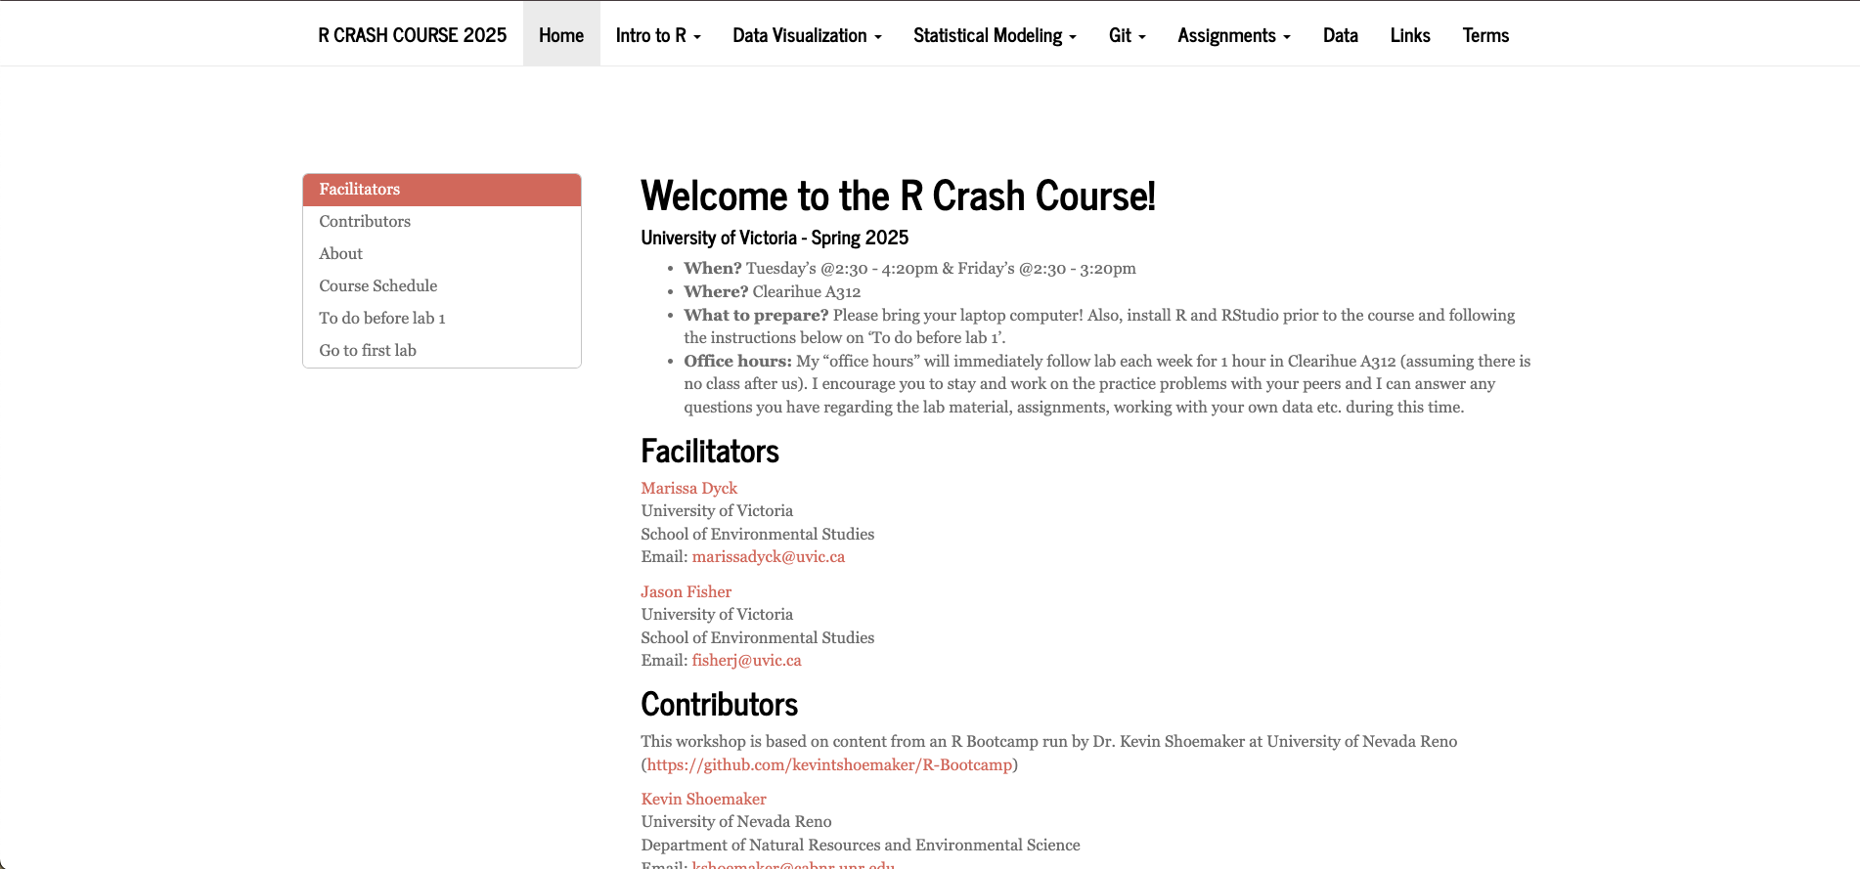

Free Intro to R Workshop
R Crash Course GitHub Link

Slide 4
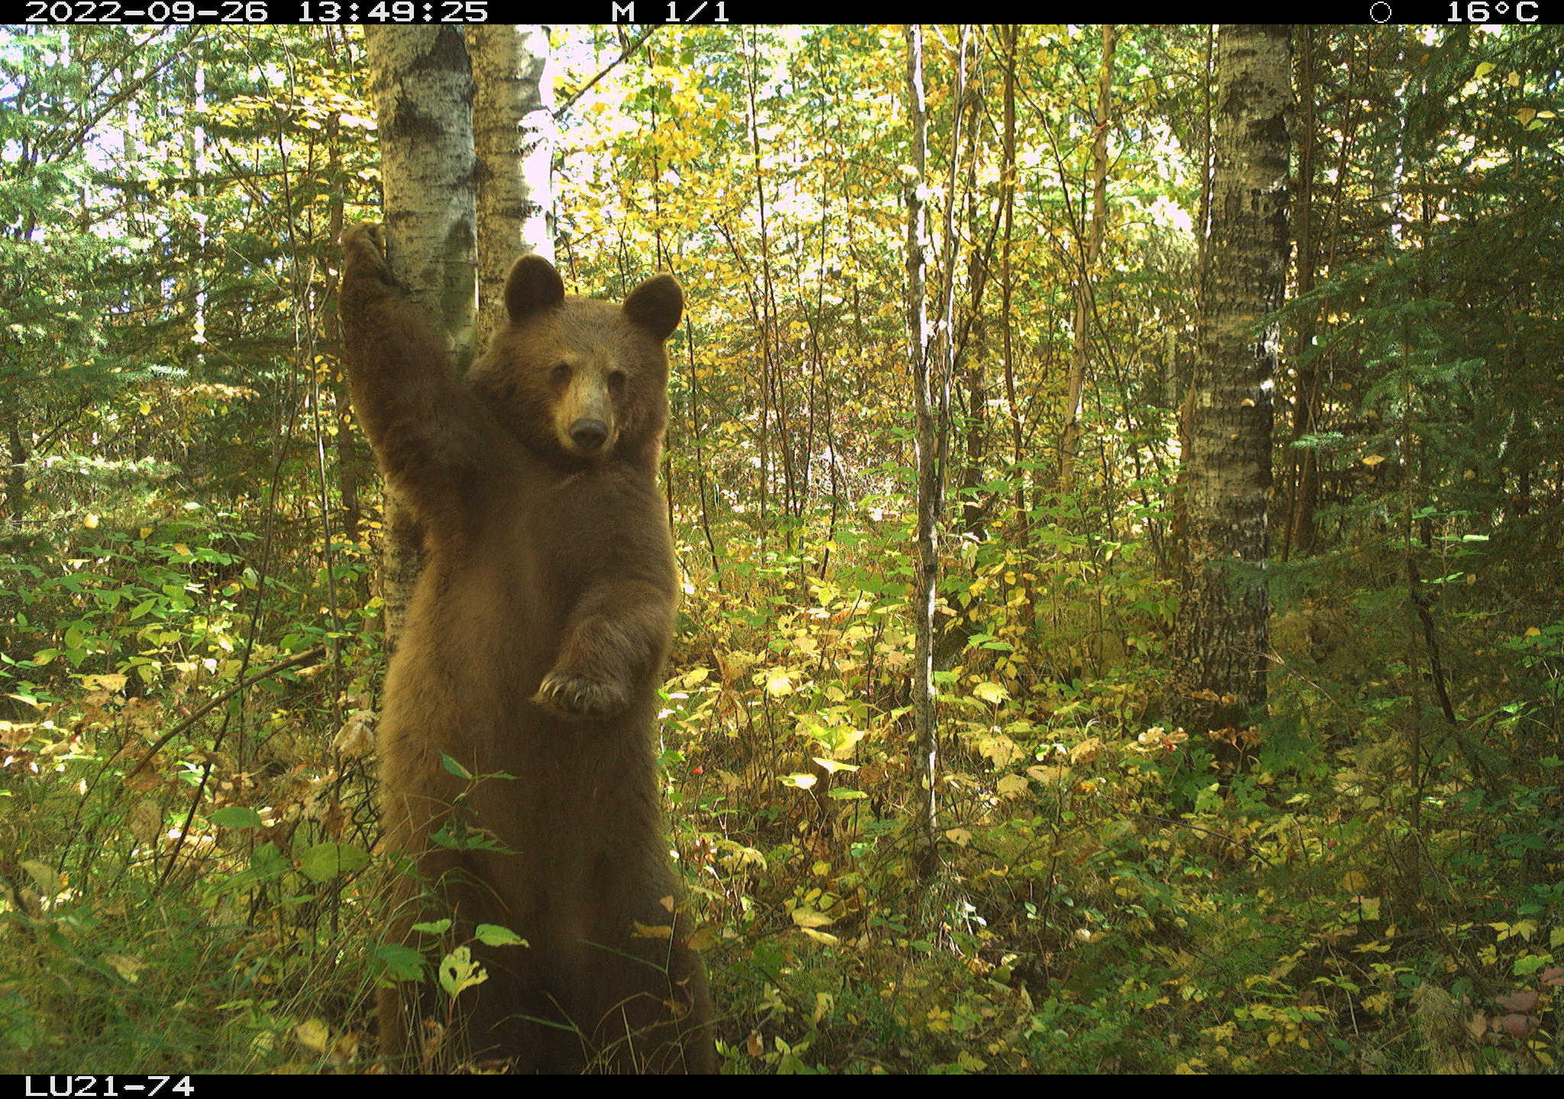
Agenda
R Overview
R Markdown
- Break -
Git/GitHub
Tidy data

Slide 5


R Overview
R: Programming language and computer software
RStudio: User-friendly interface for R programming
Notes:
You will recall you downloaded two programs for this course, R and RStudio. R itself is the programming language we will be using and the R application you downloaded is the free software environment that allows your computer to understand the coding language and perform various functions. We almost never work directly in R because it’s clunky and not straightforward; instead we work in RStudio. RStudio is a much more user friendly interface to work in. Open RStudio on your laptop and we will go over the layout and various options in RStudio. You may also want to reference the Rstudio IDE cheat sheet and take any notes you find helpful as we go.

Slide 6
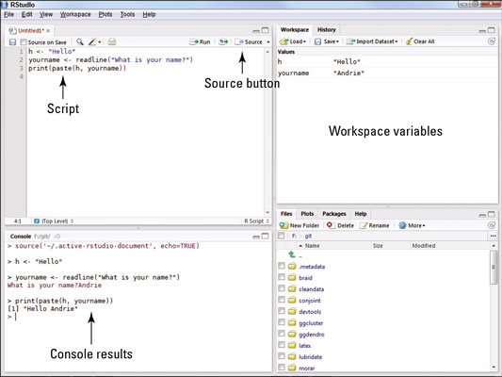
RStudio Layout
*Open RStudio on your device to follow along
Link to RStudio IDE Cheatsheet
Notes:
Source:
This is where you write your code. Code that you have written is called your R script. Anything you want evaluated in R that you want to be available later is written here. Your code is not evaluated until you run it, this can be done in a couple different ways.
Console:
The R console (what you see if you opened R directly instead of RStudio) is a command line interface, and is your direct connection with R: you give R a command at the prompt and R executes that command. The console is where your code is evaluated by R, it will show the code you have run followed by any output if there is one. Some code will not have an output in this panel (e.g., graphs), which we will cover more later. The console can also be used to write and evaluate code you only need to use once and don’t want saved in your script. This is useful for looking up help files, checking the structure of your data, and simple math such as what we just did.
Tab Panes
There are two windows with various tabs on the right, the top window is your environment/history and the lower window contains the files window and other tabs.
3. Environment/History:
The first tab of this window is the environment; this shows you objects that are currently in your working space (environment) such as data, vectors, and graphs. The second tab is your history which shows you everything you’ve evaluated during your current session.
4. Files and others:
Files:
The last window contains several tabs including files which is useful to see your directory (where you are working in your computer). You can check what you have named your data sets, open scripts, etc. without having to navigate out of RStudio. You can also create, delete, and rename folders and files directly in RStudio in this tab. When you click on files initially it will open to your current working directory, which is the file path on your computer that you are working out of. This is where your R outputs will be stored and should be where any files you want to access on your computer are also stored. Plots:
Working left to right let’s go through the remaining tabs. The plots panel is where graphs and other figures you create in R will appear. Click the plots tab*, since we haven’t created any figures there isn’t anything to see here yet.
Packages:
This tab is one way that you can install, update, and check which packages you have in your works pace. We will cover this tab more later when we start working with packages.
Help:
The help tab is where you can look up information and R documentation about various functions you may want to use. Since we haven’t covered functions yet, we will use some examples from the Base R Cheat sheet to show how this panel works.

Slide 7
How R Integrates with Your System
Working directory - The file path on your computer that you are working out of. This is where R will look (unless you tell it otherwise) for data and will save any objects you export from R to this destination.
RStudio project - Enables your work to be bundled in a self-contained folder. When you open a project your directory will automatically be set to the location where the project is saved. Allows you to easily share code.
Notes:
In order for R to use any data you have on your computer or to save files you need to tell it where to look.

Slide 8
Folder/File Structure
When creating a folder structure for a project you want to aim for these things to increase reproducibility
Well defined README
Folder names are succinct and easily understood by someone from any field
Short names, all lowercase, avoid special characters, use _ for spaces
Only include nested folders when absolutely necessary

Slide 9

Example Starting Folder Structure
GitHub Repository
e.g. thesis/dissertation chapter or project year
Rproj
A .Rproj file with the name of the repository.
data
A folder for data (e.g., csv files, shapefiles, etc.)
figures
A folder for figures made in R
code
R scripts for data formatting, analysis, and visualization
README
A well annotated file that explains all of the files in the repository
raw
Data that have not been processed in R (e.g. timelapse output, shapefiles, GIS products, etc.)
processed
Data that have been processed in R

Slide 10
Coding Best Practices
Comments:
Include a comment at the start of each code block
Include a comment for each line of code that modifies a dataset
Code spacing & formatting:
Ensure that all code is properly indented
Maintain one blank line between code blocks
Maintain one blank line between code blocks and comments or section headers. (I don’t always agree with this one)
All assignment and logical operators should be separated from other code by a leading and a trailing space
Commas should be separated from other code by a trailing space but not a leading space
Object naming/assignment:
Objects that are used in the creation of a parent object and not used again should not be assigned to the global environment
Assigned names should be in all lowercase with multiple words should be separate by a _
Only use = when providing values to the formals of a function – in all other instances use the <- assignment operator

Slide 11

Why Does This Matter?

Slide 12
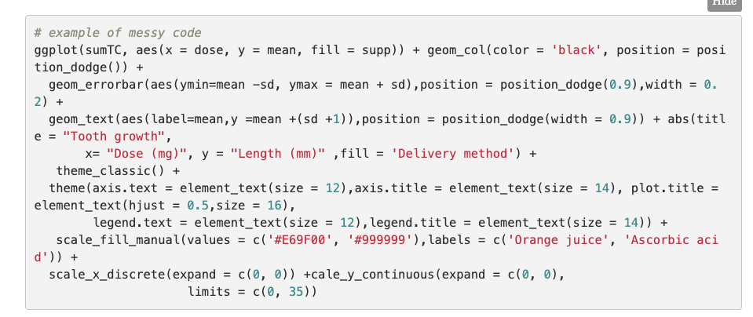

Slide 13
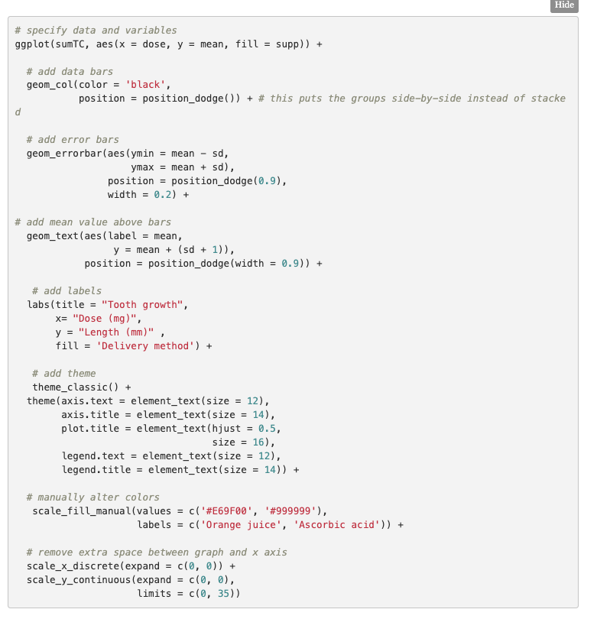
Notes:
Example of same code cleaned and tidy

Slide 14

R Markdown
R Markdown
Coding in the console
R Script

Slide 15
Benefits of R Markdown
Encourages more detailed comments/explanation of code
Differentiates between comments as a scientist and comments as a coder
Easier to organize
Can knit to pdf, html. Word doc
Saves printout of console, plots, etc
Easier sharing with non-R users
Provides analysis workflow for future you, collaborators, funders, journal reviewers, etc.
Can link data sources and other helpful web pages for later reference
Notes:
Diffeentiate though process

Slide 16
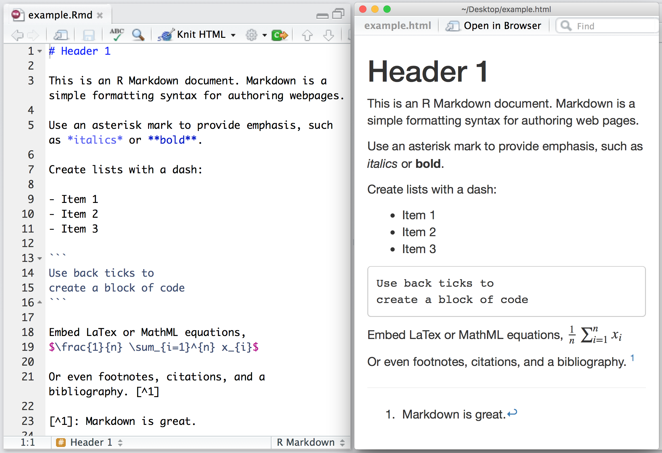
Differences R vs R Markdown
*Open the R Markdown file on your device to follow along
Link to R Markdwon Cheatsheet

Slide 17
Practice with R Markdown
In RStudio open a new R Markdown file
Modify the YAML – title, name, date
Remove existing comments and code chunks
Add the following elements to your R Markdown with headers for each section, comments, and following coding best practices
Personal info: name, pronouns, email (included as link), and why you chose this workshop
Insert a fun image of your choice and resize it
A code chunk that won’t be run when knit that installs packages (tidyverse, )
Code chunk that won’t display messages when knit that loads the installed libraries
Notes:
One of the biggest learning curves with coding is that you will never be taught everything you need to know in a course AND even if you have been taught or given code for something every dataset is different and you will need to make changes even if the code has worked before. So rather than covering examples of specific thigs and then having you practice those things in your own R Markdown file, we are going to have you practice generating an R Markdown from scratch without covering everything explicitly. You have a cheatsheet, example files, us, and the internet to help you accomplish these tasks which is what you’ll have in a real-world setting.

Slide 18
Practice with R Markdown continued…
Read in _____ data in tidy format
Explore the data a bit using functions you are familiar with, or if you are new to R use online resources or a neighbor to look up some functions that provide information about a data frame.
Generate a plot with the data
Do some data manipulation and save the new data to your environment AND to the data folder
Knit your .rmd file as a .html and .pdf

Slide 20


Slide 21
Reproducible Research Part 2 – Git/Github and tidying data
Where we’ve been
Git/Github overview
Git/Github practice
Tidying data and practicing the git/github workflow

Slide 22
LOCAL REPOSITORY (“REPO”)
Do some work on your project (write some code!)
“git add” tells git you want it to keep track of the changes you have just made
“git commit” (with a required message) then tracks the changes on the local branch, usually called “main” (and sometimes “master”).
Do more work on your project (make changes to code, write more code, etc.)
“git add” tells git you want it to keep track of the changes you have just made
“git commit” (with a required message) then tracks the changes on the local branch, usually called “main” (and sometimes “master”).
Just keep repeating this cycle until you are ready to send your record of changes to github.
e.g. main
Working branch
Staging area
Local branch
git add
git commit
Make some changes to your work
git add
git commit

Slide 23
LOCAL REPOSITORY (“REPO”)
REMOTE REPO
(GITHUB)
e.g. main
e.g. origin/main
Working branch
Staging area
Local branch
Remote tracking ref
Remote branch
git add
git commit
git push
Periodically, you want to update your remote repository with the changes you have been making.
We do that with “git push”

Slide 24
LOCAL REPOSITORY (“REPO”)
REMOTE REPO
(GITHUB)
e.g. main
e.g. origin/main
Working branch
Staging area
Local branch
Remote tracking ref
Remote branch
git add
git commit
git push
git fetch
git merge
git pull
Perhaps a colleague makes changes and pushes them to the remote branch. You want to grab those changes.
‘git fetch’ + ‘git merge’ grabs changes and lets you inspect them before merging into your code
‘git pull’ just grabs whatever is on the remote repository and pulls it into your working branch

Slide 25
LOCAL REPOSITORY (“REPO”)
REMOTE REPO
(GITHUB)
e.g. main
e.g. origin/main
Remember: Git and github are not a part of R or RStudio. You can use them for version control for any folder on your computer.
RStudio is designed to play nicely with them, so they are ideal for creating R projects that follow a reproducible workflow.
Working branch
Staging area
Local branch
Remote tracking ref
Remote branch
git add
git commit
git push
git fetch
git merge
git pull
Perhaps a colleague makes changes and pushes them to the remote branch. You want to grab those changes.
‘git fetch’ + ‘git merge’ grabs changes and lets you inspect them before merging into your code
‘git pull’ just grabs whatever is on the remote repository and pulls it into your working branch

Slide 26
Tidying Your Data
What is the “tidyverse”?
What is a “tidy” dataset?
Accessing data in a tidy dataset (let’s play!)

Slide 27
What is the “tidyverse”?
An “opinionated” set of packages for R
Built by Hadley Wickham et al.
Packages can be installed individually
e.g. install.packages(“ggplot2”)
or as a full set
e.g. install.packages(“tidyverse”)
Opinionated:
Data must be in a data frame (no vectors, matrices)
All functions receive arguments in the same order (name of data frame first)

Slide 28
Tidy datasets
What is a “tidy” data set?
Data arranged in a standardized format
Makes it easy to use across a suite of packages (e.g. tidyverse) without having to reformat
Every column is a variable; each variable is a column
Every row is an observation; each observation is a row
Each value is a cell; each cell is a single value
“long” vs “wide” format

Slide 29
Tidy datasets
Student name | Course (Mammalogy, Ecology, English literature) grades
Rosemary | 3.25, 2.75, 3.0
Andrew | 2.00, 2.25, NA
Chris | NA, 4.0, 1.5
Jane | 4.0, 3.75, 4.0
Not so tidy

Slide 30
Tidy datasets
Multiple courses
Student name | Mammalogy | Ecology | English literature
Rosemary | 3.25 | 2.75 | 3.0
Andrew | 2.00 | 2.25 | NA
Chris | NA | 4.0 | 1.5
Jane | 4.0 | 3.75 | 4.0
Multiple students
Course | Rosemary | Andrew | Chris | Jane
Mammalogy | 3.25 | 2.00 | NA | 4.0
Ecology | 2.75 | 2.25 | 4.0 | 3.75
English literature | 3.0 | NA | 1.5 | 4.0
Not so tidy

Slide 31
Tidy datasets
Student_name | Course | Grade
Rosemary | Mammalogy | 3.25
Rosemary | Ecology | 2.75
Rosemary | English literature | 3.00
Andrew | Mammalogy | 2.00
Andrew | Ecology | 2.25
Andrew | English literature | NA
Chris | Mammalogy | NA
Chris | Ecology | 4.00
Chris | English literature | 1.50
Jane | Mammalogy | 4.00
Jane | Ecology | 3.75
Jane | English literature | 4.00
Tidy!

Slide 32
Spreadsheet tips (before you even get to R…)
Pros – advantages of spreadsheets
Cons – move away from Excel
Data entry and organization
Data validation
Not for data analysis
Not very reproducible
Changes to spreadsheets are not tracked – no record of what you’ve done

Slide 33
Spreadsheet tips (before you even get to R…)
One datum per cell
Leave null values blank
Fill in actual zeros with 0
Use _ rather than space in column names
No special characters in column names
Avoid formatting
All data on one spreadsheet tab
Check out https://datacarpentry.org/lessons/#ecology for some great resources!
Let’s try it!

